Slide 1
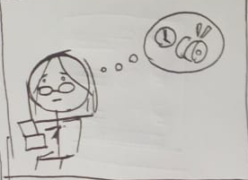
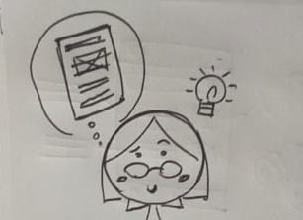
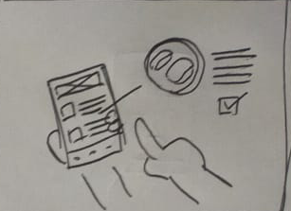
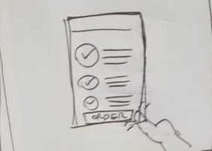
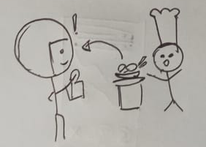
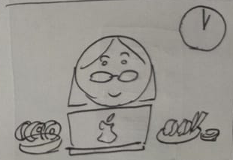
UX Design Storyboard
Scenario: an app for ordering sushi quickly and easily with knowing what the sushi is made out of.
Stephanie wants to order sushi but have no
Time to leave the office for takeout
She remembers that there’s and app that can
Deliver sushi right to your doorstep
The app automatically located her location
Then she chooses her sushi prefrences
After checking all the sushi, she proceeds
To order the sushi
The nearby restaurant will have notification of
The order and make the food for her, then a
Delivery man will deliver the sushi
Stephanie then feels relieved that her food
Made it on time for her lunch break, and get
The sushi that she wants

